Slide 1
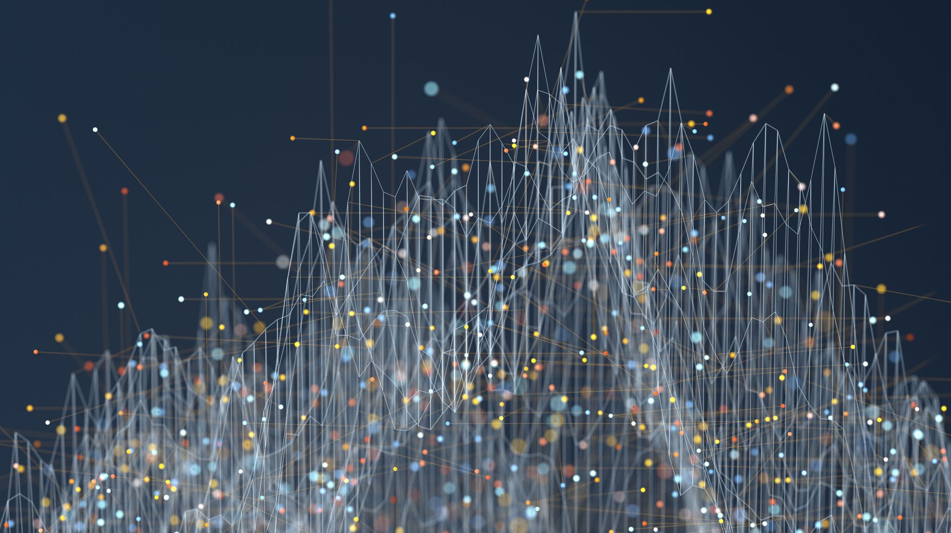
Extraction and Access to Information in Natural Language for Non-Developers - Democratizing Information
Emanuel Matos – PhD Student
Supervisors:
PhD Antonio Teixeira
PhD Mario Rodrigues
PhD Liliana Ferreira
Notes:
1 Introduction 1
1.1 Motivation.................................. 1
1.2 WhatisIE?.................................. 1
1.3 IEApplications ............................... 2
1.4 OpenProblems ............................... 2
2 Methods Review / Background and Related Work 3
2.1 Overview................................... 3
2.2 NER...................................... 4
2.3 IE....................................... 4
2.3.1 ELISA ................................ 5
2.3.2 CSD-ComputableSemanticDerivations . . . . . . . . . . . . 6
2.3.3 KnowItAll.............................. 6
2.3.4 TextRunner ............................. 6
2.3.5 OLLIE ................................ 7
2.4 OpenIE.................................... 7
2.4.1 ATP-OIE............................... 8
2.4.2 MCTS ................................ 9
2.4.3 MinIEeMinScIE .......................... 10
2.4.4 TruePIE ............................... 11
2.4.5 CoNEREL .............................. 11
2.4.6 Triplex-ST .............................. 12
2.4.7 Sequence2Sequence ........................ 14
2.4.8 ReVerb................................ 14
2.5 RecentdevelopmentsforPortuguese................... 16
2.5.1 RelP ................................. 17
2.5.2 DeptOIE............................... 18
2.5.3 PragmaticOIE............................ 18
2.5.4 DependentIE ............................ 19
2.5.5 InferReVerbPt............................ 19
2.5.6 CRF-EN-pt.............................. 20
2.5.7 RePort ................................ 21
2.5.8 ArgOE................................ 22
2.5.9 DepOE................................ 22
2.6 Datasets ................................... 23
2.7 Tools ..................................... 25
2.8 Considerations ............................... 25
3 Proposal 27
3.1 Objectives .................................. 27
3.2 Approach................................... 28
3.2.1 EngineeringDesignProcess.................... 28
3.3 Proposedsolution.............................. 29
3.4 MainTasks.................................. 29
3.5 Expectedresults............................... 31
4 Workplan 33
4.1 ResearchTimeline.............................. 33
4.2 Milestones .................................. 33
4.3 Publicationplan............................... 34
4.4 Initialwork ................................. 35
4.4.1 InitialreviewofNERandOpenIE................ 35
4.4.2 FirstselectionofNERandOpenIEtools . . . . . . . . . . . . 36
4.4.3 Dataset................................ 36
5 Conclusion
Bibliography

Slide 2

Overview
Introduction
Motivation / What is IE? / IE Applications
Open Problems
Methods Review / Background and Related Work
Overview / NER / IE / Open IE
Recent developments for Portugues
Datasets / Tools / Considerations
Proposal
Objectives
Approach
Proposed solution
Main Tasks
Expected results
Workplan
Research Timeline
Milestones
Publication plan
Initial work
Notes:
Methods Review / Background and Related Work 3
2.1 Overview................................... 3
2.2 NER...................................... 4
2.3 IE....................................... 4
2.4 OpenIE.................................... 7
2.5 RecentdevelopmentsforPortuguese................... 16
2.6 Datasets ................................... 23
2.7 Tools ..................................... 25

Slide 3
Introduction
Motivation
Open Problems
Evolution Tecnology
Democratic
NLP / Information
Relevant Content
Not Experts in NLP baseline

Slide 4
Methods Review / Background and Related Work
NER / IE / Open IE
Recent developments for Portuguese
Datasets / Tools
Notes:
2 Methods Review / Background and Related Work 3
2.1 Overview................................... 3
2.2 NER......................................(NER has a good performance as Open IE will be in part based on the entities detected by it. ) 4
2.3 IE....................................... 4
2.3.1 ELISA ................................ 5
2.3.2 CSD-ComputableSemanticDerivations . . . . . . . . . . . . 6
2.3.3 KnowItAll.............................. 6
2.3.4 TextRunner ............................. 6
2.3.5 OLLIE ................................ 7
2.4 OpenIE.................................... 7
2.4.1 ATP-OIE............................... 8
2.4.2 MCTS ................................ 9
2.4.3 MinIEeMinScIE .......................... 10
2.4.4 TruePIE ............................... 11
2.4.5 CoNEREL .............................. 11
2.4.6 Triplex-ST .............................. 12
2.4.7 Sequence2Sequence ........................ 14
2.4.8 ReVerb................................ 14
2.5 RecentdevelopmentsforPortuguese................... 16
2.5.1 RelP ................................. 17
2.5.2 DeptOIE............................... 18
2.5.3 PragmaticOIE............................ 18
2.5.4 DependentIE ............................ 19
2.5.5 InferReVerbPt............................ 19
2.5.6 CRF-EN-pt.............................. 20
2.5.7 RePort ................................ 21
2.5.8 ArgOE................................ 22
2.5.9 DepOE................................ 22
2.6 Datasets ................................... 23
2.7 Tools ..................................... 25
2.8 Considerations ............................... 25

Slide 5

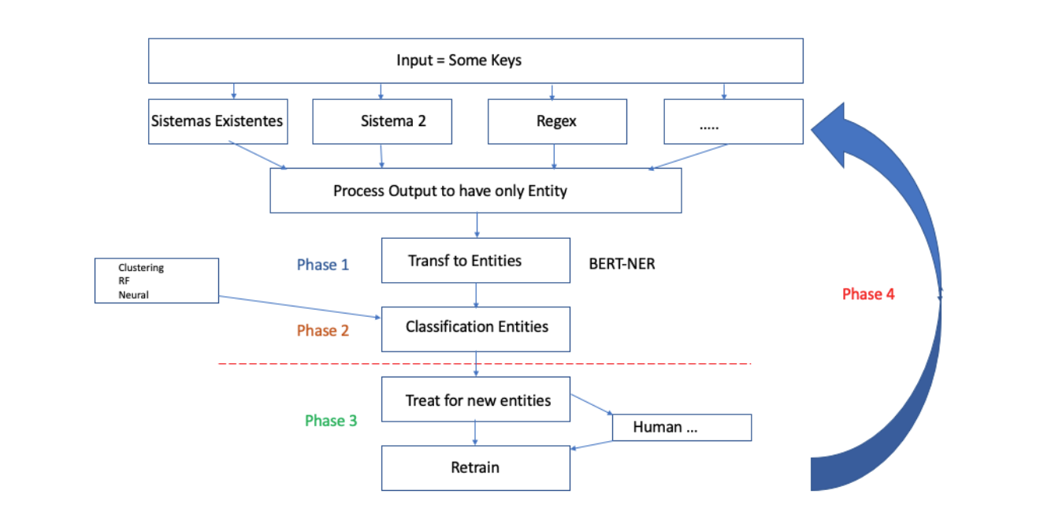
Proposal
study and develop processes to simplify the creation of information extraction pipelines for new domains;
study and develop methods to simplify access and exploration of extracted information, exploring recent developments in question answering and dialog systems;
contribute to democratization of usage of such systems by non specialists.

Slide 6
Expected results
Create an App easy to handle, with a response pattern where the result is superior to that found in approved systems and with greater difficulty in handling.
Evolving technology and the state of the art of NLP.

Slide 7
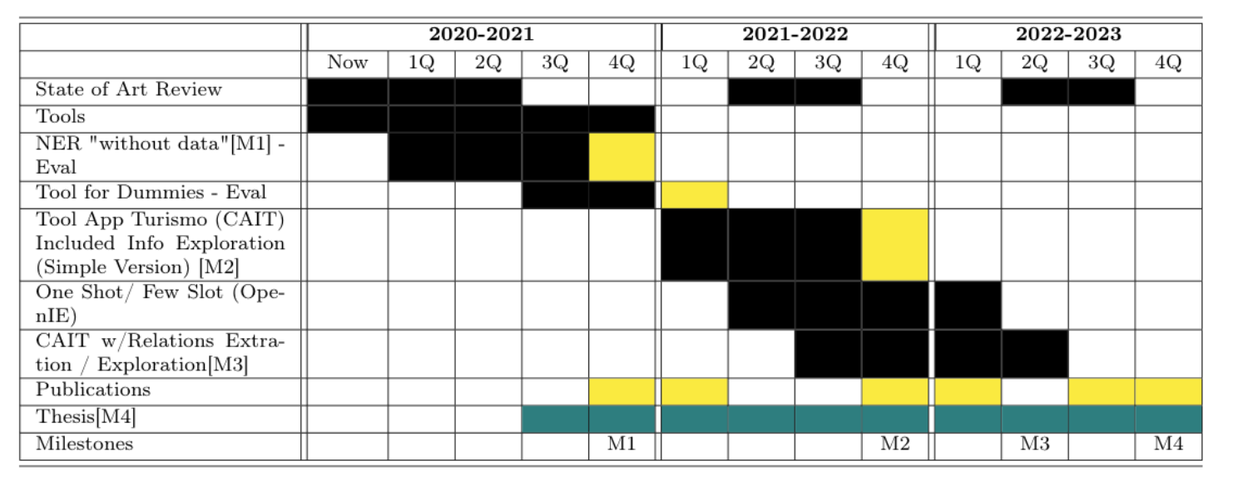
Workplan

Slide 8
Milestones
M1 - which is the 1st milestone is like the delivery of the “NER without data registration”
M2 - which is the second delivery will be the delivery of the CAIT App in a simpler version.
M3 - Will already be the delivery of CAIT in a version with Exploration of other relationships within the domain.
M4 - must be the delivery of the document with the details of how the App was developed, the technology shipped and the results obtained the delivery .
Notes:
..

Slide 9

Conclusion
The thesis proposal was proposed with its motivation, objectives and expected contributions, the risks we have, we will be mitigating throughout the process and the uncertainties when they occur will be evaluated.

Slide 10
Thanks
I would like to thank a God, my Supervisors, professors, my wife and relatives to support me to get here.

